Slide 1
GIG Zoom Meeting
Parents resource

Slide 2
OLD TESTAMENT
THE LAWS
HISTORY
Genesis
Exodus
Leviticus
Numbers
Deuteronomy
Joshua
Judges
Ruth
1 and 2 Samuel
1 and 2 kings
1 and 2 Chronicles
Ezra
Nehemiah
Esther

Slide 3
CASKET EMPTY
CASKET
EMPTY
C – CREATION
A – ABRAHAM
S – SAINI
K- KINGS
E- EXILE
T - TEMPLE
E – EXPECTATION
M – MESSAIH
P- PENTECOST
T – TEACHING
Y- YET TO COME

Slide 4
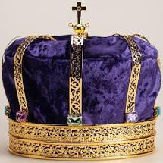
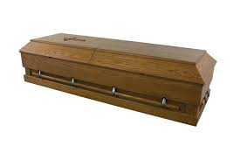
CASKET
C CREATION Genesis
God created the world
Adam and Eve sinned
Noah and the flood
The tower of Babel

Slide 5
A ABRAHAM 2100-1450 BC
God Calls Abraham out of Ur.
God promises Abraham
Many descendants
I will be with you
I will bless the all nations through you.
* Isaac was born
* Joseph

Slide 6
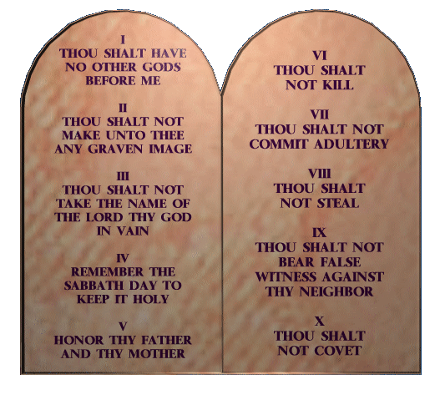
S SINAI 1450 - 1050 BC Exodus, Leviticus, Numbers, Deuteronomy, Joshua, Judges, Ruth
Moses is God’s chosen leader.
God delivers His people.
God makes a covenant with Israel at Mt. Sinai.
They wondered in the wilderness
Conquest of the “promised” land under Joshua. (Joshua)
The Israelites serve idols like other nations. (Judges)
God raises up deliverers “Judges”
God’s king is coming from the line of Judah. (Ruth)

Slide 7
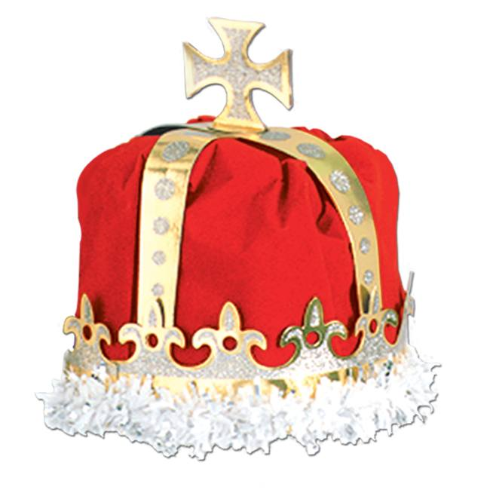
K KINGS 1050 - 586 BC 1050-930 BC united Monarchy 1ST & 2ND Samuel, 1st & 2nd Kings, 1st & 2nd Chronicles
Red crown represent kings chosen by men. (not from the royal line of Judah)
Blue crown represent Kings chosen by God.
Saul
- Line of Benjamin
Disobeyed God
Rejected King
David
- God’s chosen
- God promised him he will have everlasting kingdom (Jesus)
Solomon
Built a temple
Wise king
But many wives and Idols

Slide 8
Kingdom Divided 930-586 BC
Northern Kingdom
Southern Kingdom
Ten tribes of Israel
Jeroboami
Built alters to worship idols
The idols stayed for 200 years
722 BC They were taken by Assyrian Empire.
Tribe of Judah and Benjamin
Along with priestly tribe of Levi
(2 chronicle 11:13-17)
Rehoboam Solomon’s Son
Few kings served God faithfully.
(Asa, Jehoshaphat, Hezekiah and Josiah)
Most did evil in God’s sight.
650 BC they were taken by Babylonian Empire.

Slide 9
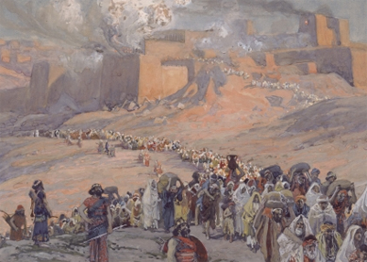
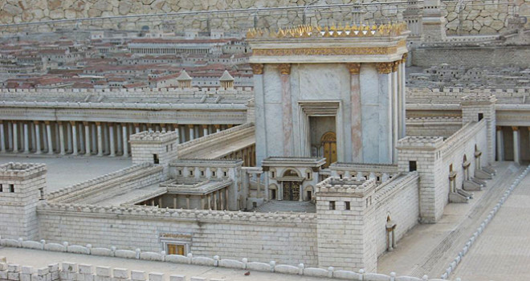
E EXILE 586 - 539 BC Babylonian Empire Jeremiah, Lamentations, Ezekiel, Daniel Obadiah
Prophets
God’s promises
Ezekiel
Daniel
Jeramiah
Obadiah
Make a new covenant
New heart and Spirit
Forgive their sin
Raise up a righteous Davidic
King
Jerusalem and the temple
will be rebuilt

Slide 10
T TEMPLE 539 - 430 BC Persian Empire
Prophets
Kings
Haggai
- Build God’s house
Zechariah
- Prophesied about Jesus
Royal branch of David will build God’s temple
King will come on a donkey
Jerusalem will be a blessing to all the nation
Malachi (Last prophet)
- Prophesied about John the Baptist and Jesus
Daniel
Cyrus 539 BC
Allows the Israelites to return to Jerusalem
Some returned and some stayed
Started building the temple but stopped because of opposition
Darius 522-486
- Temple building resumes
Xerxes I 486-465
- The story of Esther
Artaxerxes 465-424
The second return from Exile

