Slide 1
CASKET EMPTY
New Testament
EMPTY

Slide 2
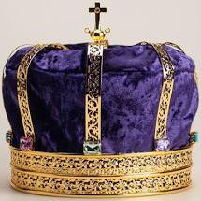
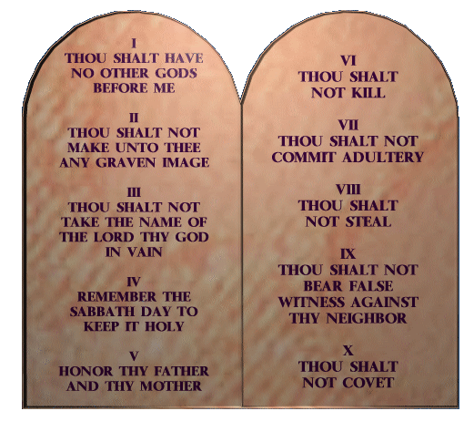
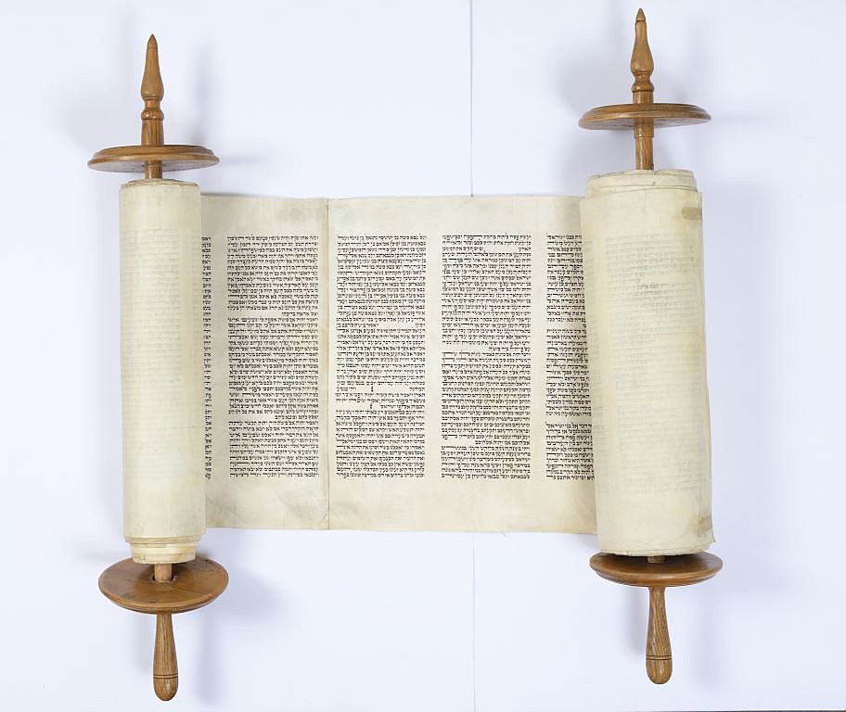
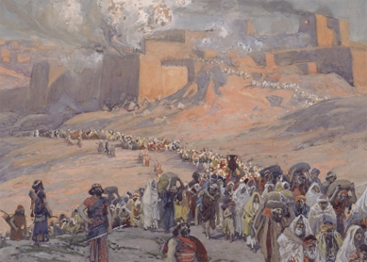
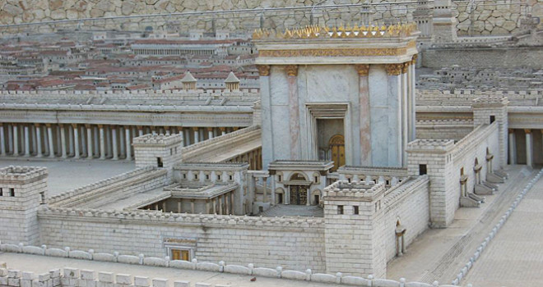
CASKET EMPTY
CASKET (OT)
EMPTY (NT)
C – CREATION
A – ABRAHAM
S – SAINI
K- KINGS
E- EXILE
T – TEMPLE
E – EXPECTATION
M – MESSAIH
P- PENTECOST
T – TEACHING
Y- YET TO COME

Slide 3
New Testament

Slide 4
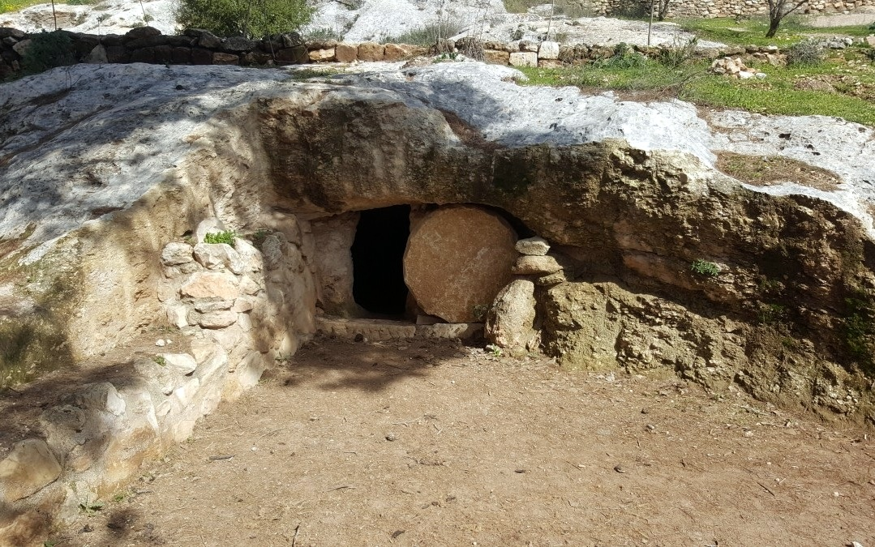
E EXPECTATIONS Israel Expects the Messiah: awaiting the Old Testament promises of God.
KINGDOM OF GOD as coming to reign of God(Zech 14:9)
* Royal SON OF MAN will come to rule.(Dan.7:11-14)
SON OF DAVID RESTORED to the throne. (Jer.23:5)
ATONMENT FOR SIN(Isa 53; Dan 9:24)
NEW COVENANT
(Jer.31:31-34; Hos.2:16:23)
Pouring out the HOLY SPIRIT.
(Isa.44:3;Joel 2:28-29)
Blessings of ABRAHM to the nations.
(Gen 12:1-3; Mic 4)
RESURRECTION of the dead
(Ezek. 37; Isa.25:8-9;Dan 12:1)
NEW CREATION.
(Isa.65-66)

Slide 5
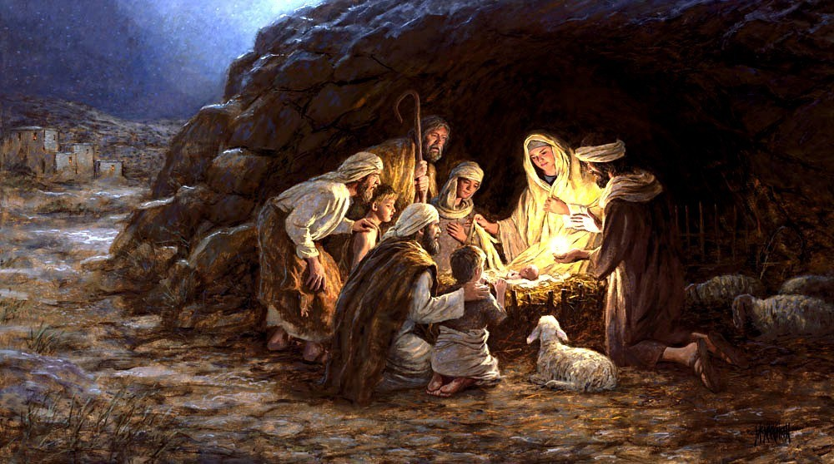
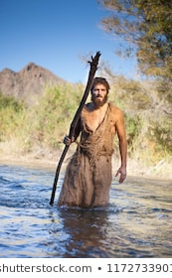
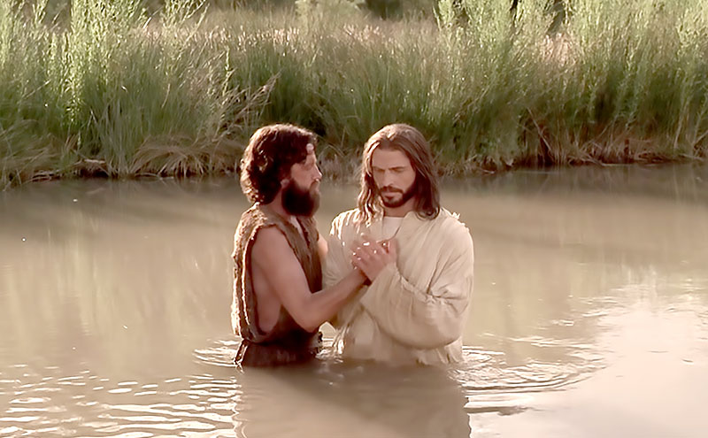
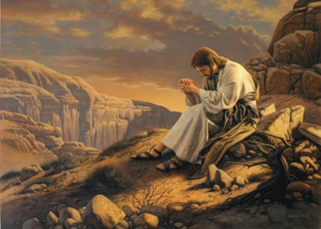
M MESSIAH
Jesus the son of David, the son of Abraham (Matthew 1-2)
The word of the Lord came to John in the wilderness.
Jesus was Baptized by John.
Jesus was tempted.

Slide 6
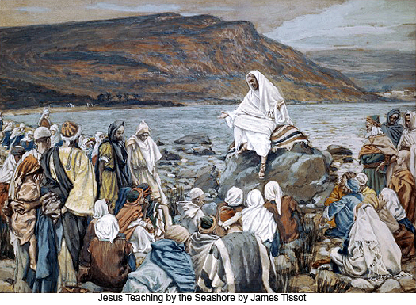
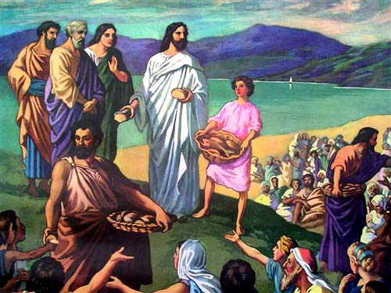
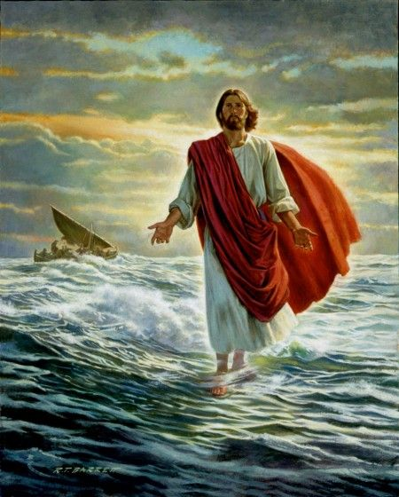
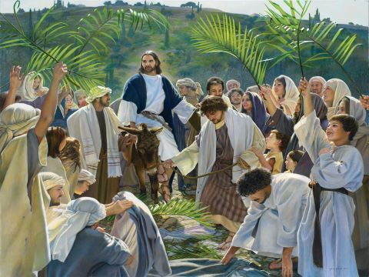
M MESSIAH
Jesus proclaims the gospel of the Kingdom
1. Teaching
Sermon on the Mount
Parables
2. Performing Miracles.
5 loaves of bread and two fish.
He raised the dead
He walked on water.
3. Some people raised opposition to Jesus’ preaching about the kingdom
Peter confess Jesus as Messiah, Son of God.
Jesus told his disciples that he must suffer, die and raise from the dead.
4. Jesus entered Jerusalem as Son of David on Palm Sunday.

Slide 7
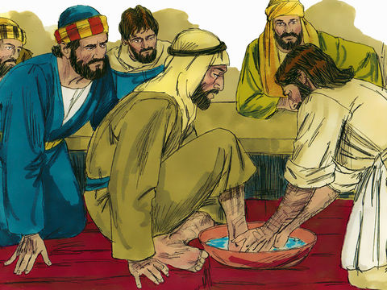
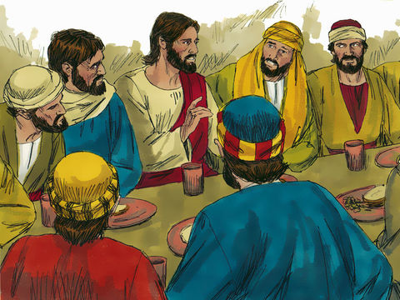
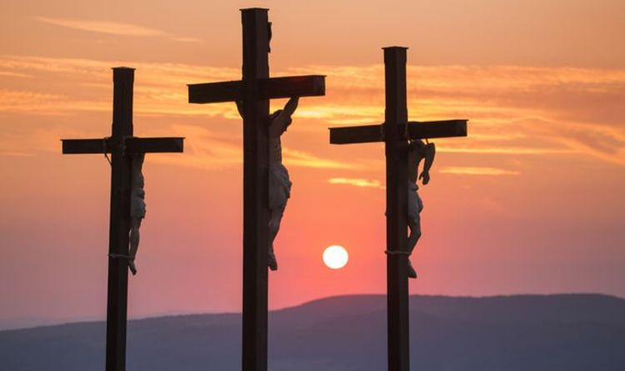
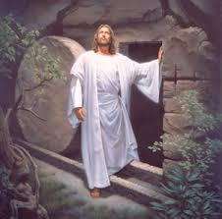
M MESSIAH
Jesus celebrates the Passover/
Last Supper with His disciples
Jesus is crucified for the sin of the world.
Jesus is resurrected from the dead.

Slide 8
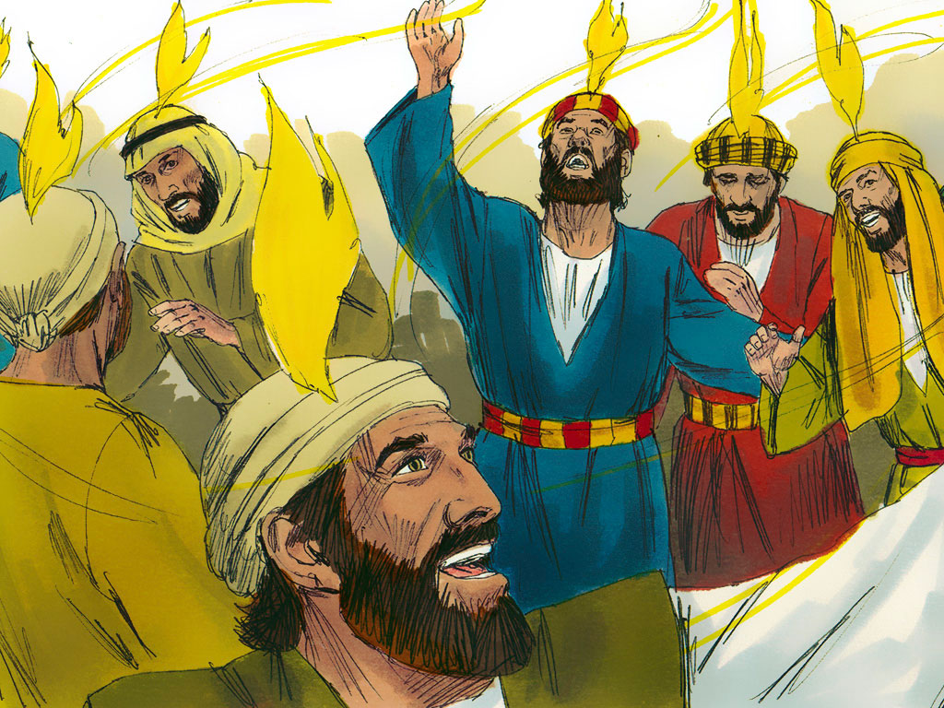
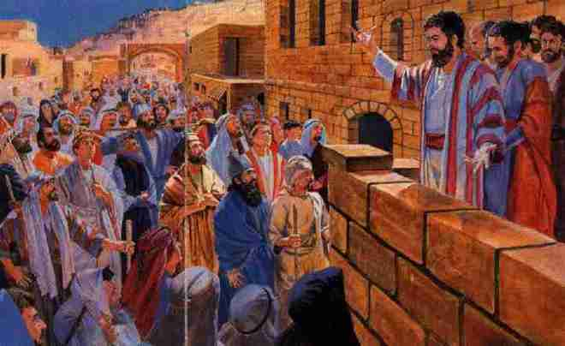
P PENTECOST
God pours out His Holy Spirit upon the church.
Jesus extended His Kingdom to Jerusalem.
Jesus Extends His kingdom into Judea and Samaria.

Slide 9
T TEACHING
Their teachings are recorded in the New Testament. There are 21 letters in New Testament. Some were written to churches, and some were written to individual people.
9 letters Paul wrote to churches “ANS” | 4 letters Paul wrote to individual | 8 letters were written by other Disciples
ROMANS 1 and 2 CORINTHIANS GALATIANS EPHESIANS PHILIPPIANS COLOSSIANS 1 and 2 THESSALONIANS | 1 and 2 TIMOTHY TITUS PHILEMON | HEBREWS JAMES 1 and 2 PETER 1, 2 3 JOHN JUDE

Slide 10
Y YET TO COME
John saw a vision what will take place in the future.
Jesus is coming back.
Jesus will be exalted.
He will make all things new.

